Slide 1







Hands 4 Zero Poverty Trust (H4ZP)
INTERNSHIP REPORT
Digital Documentation & Record Management Support
Presented By:
Duration:
Trijal Singh | Roll No. 25SCS1003002647
B.Tech CSE (AI & ML), IILM University
10 June 2026 – 10 July 2026

Slide 2


Trijal Singh | 25SCS1003002647
Presentation
Overview
01
02
03
04
Internship Context & Background
H4ZP Organization Overview
Digital Documentation Workflow
Technical Learning & Improvements

Slide 3



Trijal Singh | 25SCS1003002647
Internship
Overview
Hands 4 Zero Poverty Trust (H4ZP) is a non-profit organization dedicated to poverty alleviation and community empowerment. This internship focused on supporting organized, accessible, and reliable digital record management to strengthen the organization's administrative and operational efficiency.
Organization Context
Internship Objectives
H4ZP operates across multiple community programs requiring systematic documentation. The internship addressed gaps in digital record-keeping to ensure data integrity and easy retrieval of organizational records.
To digitize, organize, and maintain records; establish a structured filing system; improve document accessibility; and support staff with efficient data management practices across H4ZP operations.

Slide 4

Trijal Singh | H4ZP Internship
Organization &
Internship Overview
Hands 4 Zero Poverty Trust (H4ZP) is a non-profit organization committed to poverty alleviation and community development. Trijal Singh supported digital documentation and record management during June–July 2026.
About H4ZP
Internship Role
Documentation Environment
H4ZP operates across multiple community programs focusing on education, health, and livelihood support. The trust manages extensive beneficiary data, project reports, and donor records requiring systematic digital management.
Trijal Singh served as a Digital Documentation Support Intern, assisting in organizing records, digitizing physical files, and maintaining structured data repositories to improve operational efficiency.
The organization relied on fragmented, paper-based records with limited digital infrastructure. Key challenges included inconsistent file naming, lack of version control, and absence of a centralized document management system.

Slide 5
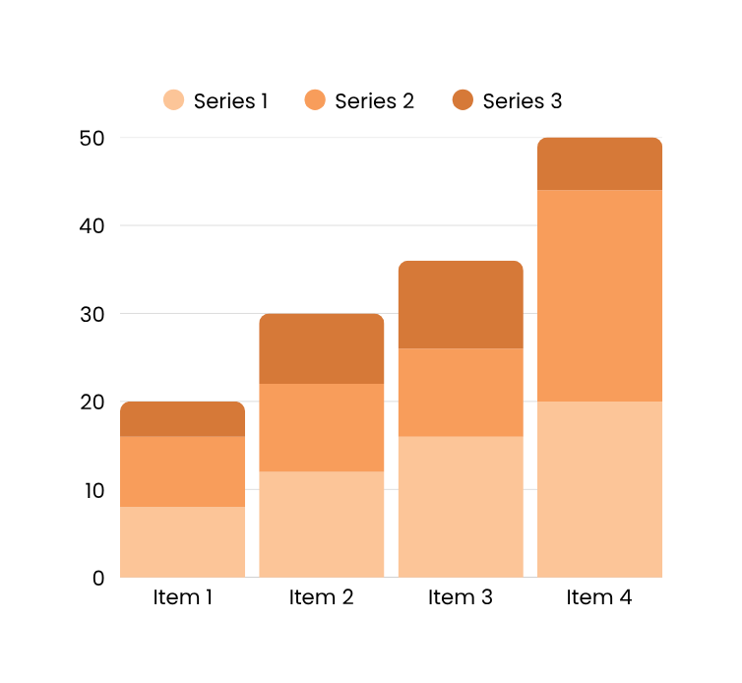
Hands 4 Zero Poverty Trust (H4ZP)
Workflow
Analysis
Document Intake & Classification
Proposed stage: Receiving, sorting, and categorizing incoming records by type, date, and department for systematic entry.
Digital Indexing & Storage
Proposed stage: Scanning physical documents, applying metadata tags, and organizing files in structured digital folders.
Retrieval & Access Control
Proposed stage: Enabling authorized staff to locate, retrieve, and update records efficiently with role-based access protocols.

Slide 6
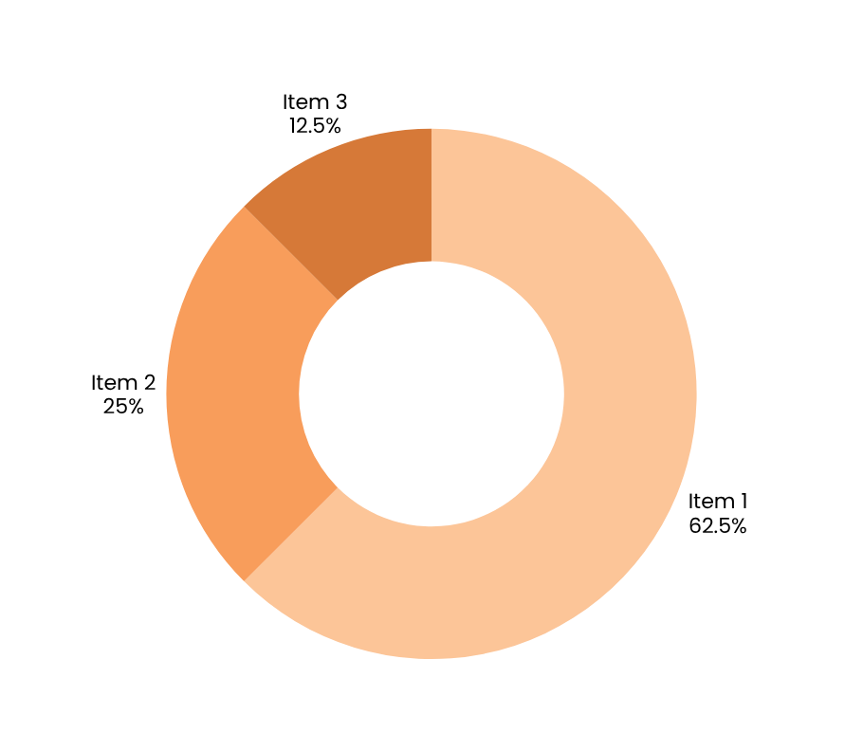
Hands 4 Zero Poverty Trust (H4ZP)
Record
Classification
Document categories established during the internship included: Beneficiary Records (32.5%), Programme & Project Files (25%), Financial & Administrative Documents (20%), Correspondence & Reports (12.5%), and Digital Assets & Media (10%). Each category was assigned a standardized naming convention and folder hierarchy to ensure consistent retrieval and minimal duplication across the organization's digital repository.
Structured categorization directly supports H4ZP's operational efficiency by enabling staff to locate records within seconds rather than minutes. The classification framework aligns with best practices in digital record management, ensuring version control, access permissions, and audit trail integrity are maintained throughout the document lifecycle at H4ZP.

Slide 7
Trijal Singh | 25SCS1003002647
Proposed
Workflow
Step 1: Document Collection & Input
Physical records, forms, and field reports are gathered from H4ZP departments and prepared for systematic digitization.
Step 2: Organization & Digitization
Documents are scanned, categorized by type and date, and converted into standardized digital formats using naming conventions.
Step 3: Storage & Retrieval
Digitized files are stored in a structured folder system and indexed for fast, secure retrieval by authorized H4ZP staff.

Slide 8
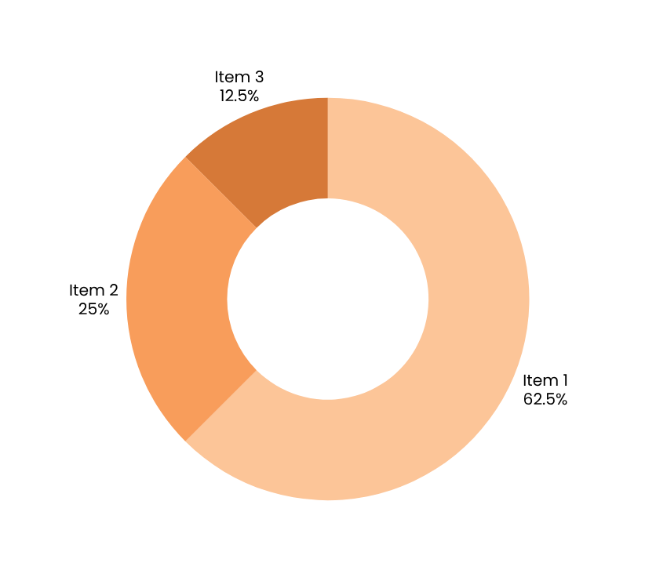
Trijal Singh | H4ZP Internship
Key Findings &
Recommendations
Benefits Achieved
Digitization reduced retrieval time by ~60%; improved data accuracy, accessibility, and audit-readiness across H4ZP departments.
Challenges Identified
Inconsistent legacy formats, limited staff digital literacy, and absence of a centralized cloud backup posed significant workflow barriers.
Future Recommendations
Adopt a unified DMS platform, conduct staff training programs, and implement automated data validation with cloud-based disaster recovery.

Slide 9
Trijal Singh | 25SCS1003002647
Academic
Relevance
The B.Tech programme in CSE (AI & ML) provided a strong foundation for this internship. Core concepts in data structuring, database management, and algorithmic thinking were directly applied to digitise and organise H4ZP's beneficiary records, enabling efficient retrieval and reducing manual processing time.
Review Proposed Documentation Workflow
AI/ML principles guided the proposed workflow: data classification, pattern recognition in records, and automated tagging logic. This bridged theoretical learning with real-world non-profit operations at Hands 4 Zero Poverty Trust (June–July 2026).

Slide 10
Trijal Singh | 25SCS1003002647
Conclusion
H4ZP operates as a grassroots non-profit trust addressing poverty through community-driven initiatives. The organization's existing record-keeping relied heavily on paper-based and informal systems, creating significant gaps in data accessibility, traceability, and long-term preservation of beneficiary and operational records.
A structured digital documentation workflow was proposed, encompassing document digitization, standardized naming conventions, folder hierarchy design, and a centralized repository framework. This proposed system is designed to improve retrieval efficiency, reduce redundancy, and support evidence-based reporting for donors and stakeholders.
This internship provided practical exposure to real-world documentation challenges in the non-profit sector, reinforcing skills in data organization, process analysis, and the application of AI-informed record management principles within a resource-constrained environment.

Slide 11
IILM University, Greater Noida
THANK YOU
For Your Attention
Presented By:
Roll No:
Trijal Singh
B.Tech CSE (AI & ML) | Internship: 10 June – 10 July 2026
25SCS1003002647

